Slide 1
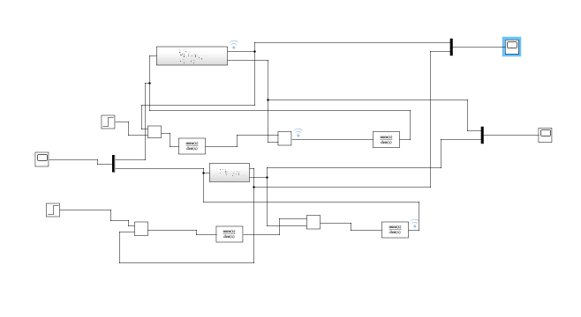
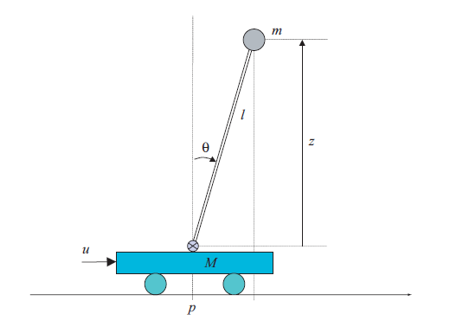
Control Systems
Project: Control of Inverted Pendulum
Instructor: Giuseppe calafiore, Phd
Students: Pham Van Long
Phan Nhat Huy

Slide 2
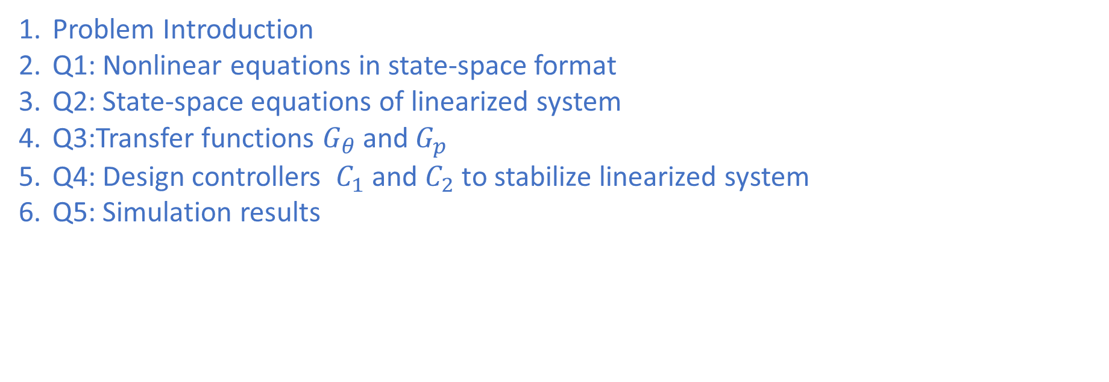
Agenda
Problem Introduction
Q1: Nonlinear equations in state-space format
Q2: State-space equations of linearized system
Q3:Transfer functions $G_{θ}$ and $G_{p}$
Q4: Design controllers $C_{1}$ and $C_{2}$ to stabilize linearized system
Q5: Simulation results

Slide 3
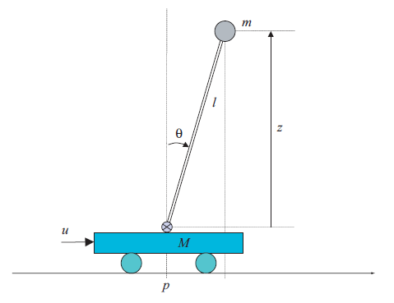
Problem introduction
Control of Inverted pendulum
We want to design linearized controllers satisfying some specs that apply on actual non-linear system given the dynamics of the inverted pendulum.

Slide 4
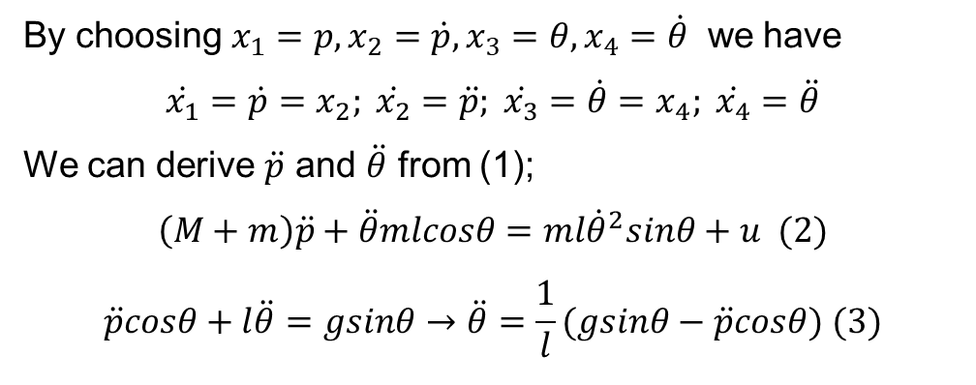

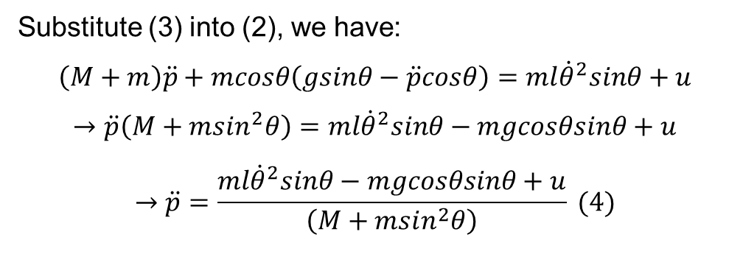
Q1: State-space model of non-linear system
Control of Inverted pendulum
$\left[\begin{matrix}M+m & mlcosθ \\ cosθ & l\end{matrix}\right]\left[\begin{matrix}\ddot{p} \\ \ddot{θ}\end{matrix}\right]=\left[\begin{matrix}ml{\dot{θ}}^{2}sinθ+u \\ gsinθ\end{matrix}\right]$, (1)
By choosing $x_{1}=p, x_{2}=\dot{p}, x_{3}=θ, x_{4}=\dot{θ}$ we have
$$\dot{x_{1}}=\dot{p}=x_{2}; \dot{x_{2}}=\ddot{p}; \dot{x_{3}}=\dot{θ}=x_{4}; \dot{x_{4}}=\ddot{θ}$$
We can derive $\ddot{p}$ and $\ddot{θ}$ from (1);
$$\left(M+m\right)\ddot{p}+\ddot{θ}mlcosθ=ml{\dot{θ}}^{2}sinθ+u (2)$$
$$\ddot{p}cosθ+l\ddot{θ}=gsinθ→\ddot{θ}=\frac{1}{l}(gsinθ−\ddot{p}cosθ) (3)$$
Substitute (3) into (2), we have:
$$\left(M+m\right)\ddot{p}+mcosθ\left(gsinθ−\ddot{p}cosθ\right)=ml{\dot{θ}}^{2}sinθ+u$$
$$→\ddot{p}\left(M+msin^{2}θ\right)=ml{\dot{θ}}^{2}sinθ−mgcosθsinθ+u$$
$$→\ddot{p}=\frac{ml{\dot{θ}}^{2}sinθ−mgcosθsinθ+u}{\left(M+msin^{2}θ\right)} (4)$$

Slide 5
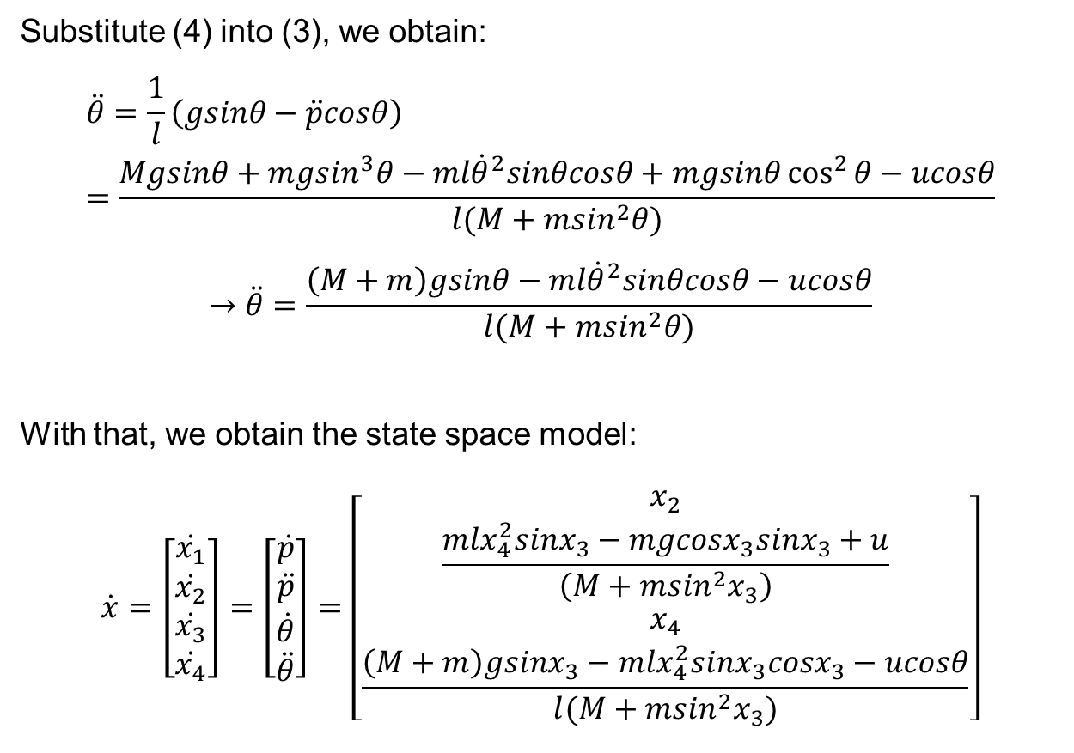
Q1: State-space model of non-linear system
Control of Inverted pendulum
Substitute (4) into (3), we obtain:
$$\ddot{θ}=\frac{1}{l}\left(gsinθ−\ddot{p}cosθ\right)=\frac{Mgsinθ+mgsin^{3}θ−ml{\dot{θ}}^{2}sinθcosθ+mgsinθ\cos^{2}{θ}−ucosθ}{l(M+msin^{2}θ)}$$
$$→\ddot{θ}=\frac{\left(M+m\right)gsinθ−ml{\dot{θ}}^{2}sinθcosθ−ucosθ}{l(M+msin^{2}θ)}$$
With that, we obtain the state space model:
$$\dot{x}=\left[\begin{matrix}\dot{x_{1}} \\ \dot{x_{2}} \\ \dot{x_{3}} \\ \dot{x_{4}}\end{matrix}\right]=\left[\begin{matrix}\dot{p} \\ \ddot{p} \\ \dot{θ} \\ \ddot{θ}\end{matrix}\right]=\left[\begin{matrix}x_{2} \\ \frac{mlx_{4}^{2}sinx_{3}−mgcosx_{3}sinx_{3}+u}{\left(M+msin^{2}x_{3}\right)} \\ x_{4} \\ \frac{\left(M+m\right)gsinx_{3}−mlx_{4}^{2}sinx_{3}cosx_{3}−ucosθ}{l(M+msin^{2}x_{3})}\end{matrix}\right]$$

Slide 6
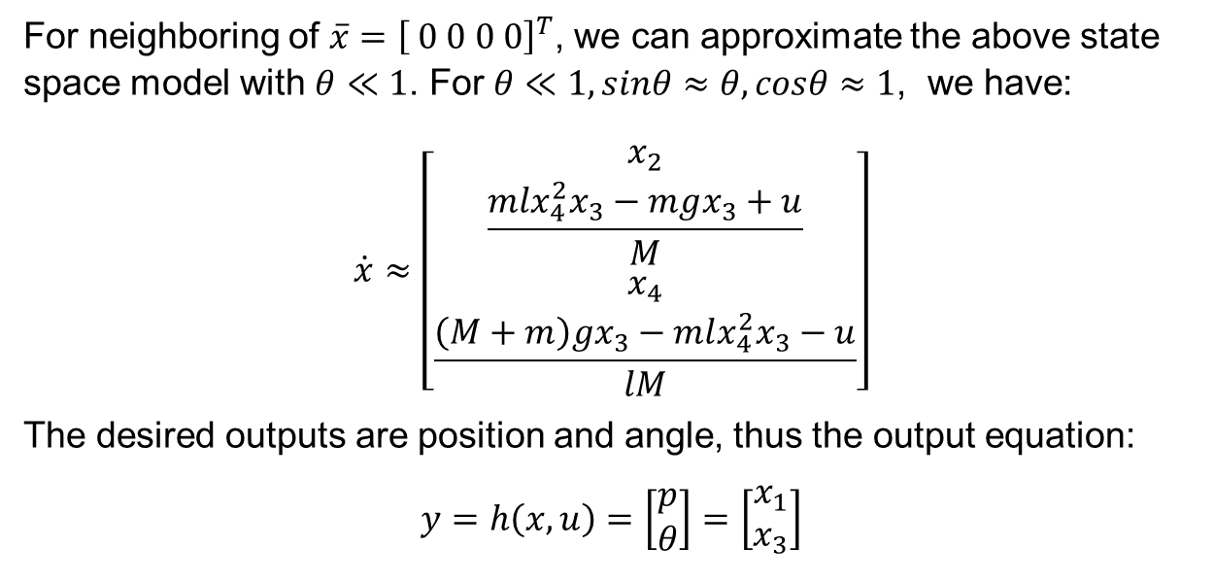
Q2: State-space model of linearized system
Control of Inverted pendulum
For neighboring of $\overline{x}={\left[ 0 0 0 0\right]}^{T}$, we can approximate the above state space model with $θ≪1$. For $θ≪1, sinθ≈θ, cosθ≈1$, we have:
$$\dot{x}≈\left[\begin{matrix}x_{2} \\ \frac{mlx_{4}^{2}x_{3}−mgx_{3}+u}{M} \\ x_{4} \\ \frac{\left(M+m\right)gx_{3}−mlx_{4}^{2}x_{3}−u}{lM}\end{matrix}\right]$$
The desired outputs are position and angle, thus the output equation:
$$y=h\left(x,u\right)=\left[\begin{matrix}p \\ θ\end{matrix}\right]=\left[\begin{matrix}x_{1} \\ x_{3}\end{matrix}\right]$$

Slide 7
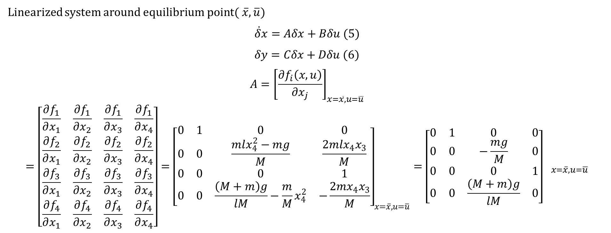
Q2: State-space model of linearized system
Control of Inverted pendulum
Linearized system around equilibrium point$( \overline{x}, \overline{u})$
$$\dot{δ}x=Aδx+Bδu (5)$$
$$δy=Cδx+Dδu (6)$$
$$A={\left[\frac{∂f_{i}\left(x,u\right)}{∂x_{j}}\right]}_{x=\overline{x},u=\overline{u}}={\left[\begin{matrix}\frac{∂f_{1}}{∂x_{1}} & \frac{∂f_{1}}{∂x_{2}} & \frac{∂f_{1}}{∂x_{3}} & \frac{∂f_{1}}{∂x_{4}} \\ \frac{∂f_{2}}{∂x_{1}} & \frac{∂f_{2}}{∂x_{2}} & \frac{∂f_{2}}{∂x_{3}} & \frac{∂f_{2}}{∂x_{4}} \\ \frac{∂f_{3}}{∂x_{1}} & \frac{∂f_{3}}{∂x_{2}} & \frac{∂f_{3}}{∂x_{3}} & \frac{∂f_{3}}{∂x_{4}} \\ \frac{∂f_{4}}{∂x_{1}} & \frac{∂f_{4}}{∂x_{2}} & \frac{∂f_{4}}{∂x_{3}} & \frac{∂f_{4}}{∂x_{4}}\end{matrix}\right]={\left[\begin{matrix}0 & 1 & 0 & 0 \\ 0 & 0 & \frac{mlx_{4}^{2}−mg}{M} & \frac{2mlx_{4}x_{3}}{M} \\ 0 & 0 & 0 & 1 \\ 0 & 0 & \frac{\left(M+m\right)g}{lM}−\frac{m}{M}x_{4}^{2} & −\frac{2mx_{4}x_{3}}{M}\end{matrix}\right]}_{x=\overline{x}, u=\overline{u}}=\left[\begin{matrix}0 & 1 & 0 & 0 \\ 0 & 0 & −\frac{mg}{M} & 0 \\ 0 & 0 & 0 & 1 \\ 0 & 0 & \frac{\left(M+m\right)g}{lM} & 0\end{matrix}\right] }_{x=\overline{x},u=\overline{u}}$$

Slide 8
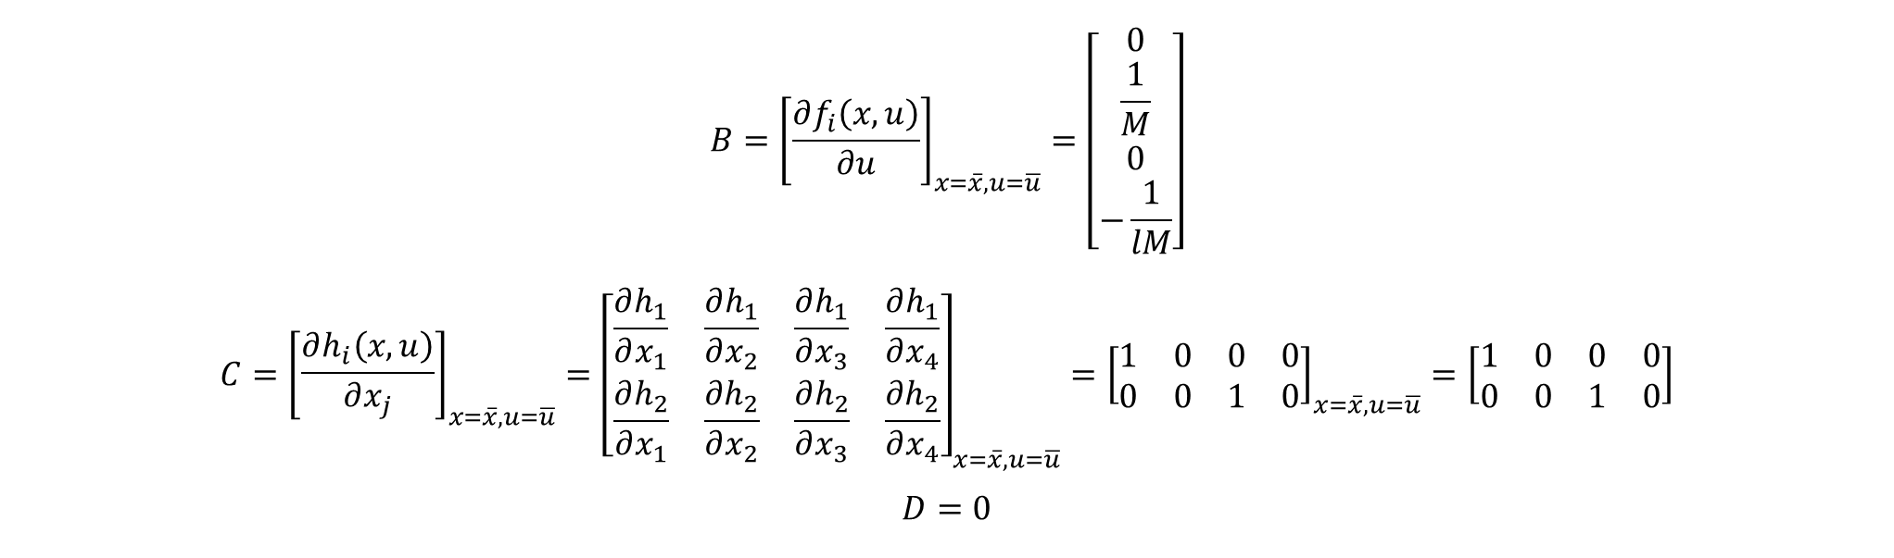
Q2: State-space model of linearized system
Control of Inverted pendulum
$$B={\left[\frac{∂f_{i}\left(x,u\right)}{∂u}\right]}_{x=\overline{x},u=\overline{u}}=\left[\begin{matrix}0 \\ \frac{1}{M} \\ 0 \\ −\frac{1}{lM}\end{matrix}\right]$$
$$C={\left[\begin{matrix}\frac{∂h_{i}\left(x,u\right)}{∂x_{j}}\end{matrix}\right]}_{x=\overline{x},u=\overline{u}}={\left[\begin{matrix}\frac{∂h_{1}}{∂x_{1}} & \frac{∂h_{1}}{∂x_{2}} & \frac{∂h_{1}}{∂x_{3}} & \frac{∂h_{1}}{∂x_{4}} \\ \frac{∂h_{2}}{∂x_{1}} & \frac{∂h_{2}}{∂x_{2}} & \frac{∂h_{2}}{∂x_{3}} & \frac{∂h_{2}}{∂x_{4}}\end{matrix}\right]}_{x=\overline{x},u=\overline{u}}={\left[\begin{matrix}1 & 0 & 0 & 0 \\ 0 & 0 & 1 & 0\end{matrix}\right]}_{x=\overline{x},u=\overline{u}}=\left[\begin{matrix}1 & 0 & 0 & 0 \\ 0 & 0 & 1 & 0\end{matrix}\right]$$
$$D=0$$

Slide 9

Q2: State-space model of linearized system
Control of Inverted pendulum
Stability Discussion
Assessing the matrix:
$$A=\left[\begin{matrix}0 & 1 & 0 & 0 \\ 0 & 0 & −\frac{mg}{M} & 0 \\ 0 & 0 & 0 & 1 \\ 0 & 0 & \frac{\left(M+m\right)g}{lM} & 0\end{matrix}\right]$$
The characteristic polynomial:
$$p\left(λ\right)=\det\left(sI−A\right)=det\left[\begin{matrix}s & −1 & 0 & 0 \\ 0 & s & \frac{mg}{M} & 0 \\ 0 & 0 & s & −1 \\ 0 & 0 & \frac{−\left(M+m\right)g}{lM} & s\end{matrix}\right]$$

Slide 10
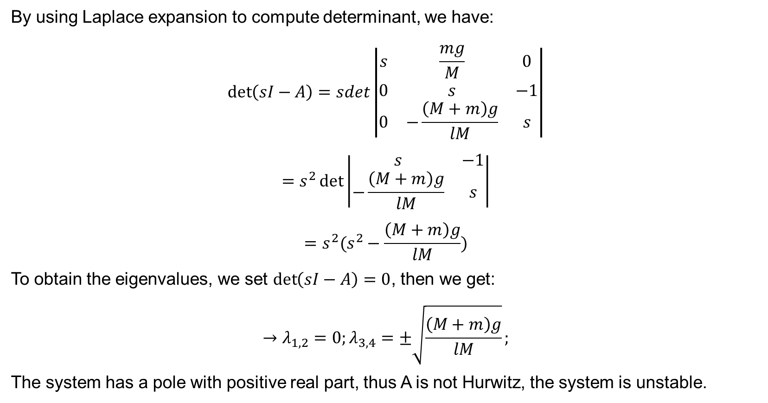
Q2: State-space model of linearized system
Control of Inverted pendulum
By using Laplace expansion to compute determinant, we have:
$$\det\left(sI−A\right)=sdet\left|\begin{matrix}s & \frac{mg}{M} & 0 \\ 0 & s & −1 \\ 0 & −\frac{\left(M+m\right)g}{lM} & s\end{matrix}\right|$$
$$=s^{2}\det\left|\begin{matrix}s & −1 \\ −\frac{\left(M+m\right)g}{lM} & s\end{matrix}\right|$$
$$=s^{2}(s^{2}−\frac{\left(M+m\right)g}{lM})$$
To obtain the eigenvalues, we set $\det\left(sI−A\right)=0$, then we get:
$$→λ_{1,2}=0;λ_{3,4}=±\sqrt{\frac{\left(M+m\right)g}{lM}};$$
The system has a pole with positive real part, thus A is not Hurwitz, the system is unstable.

Slide 11
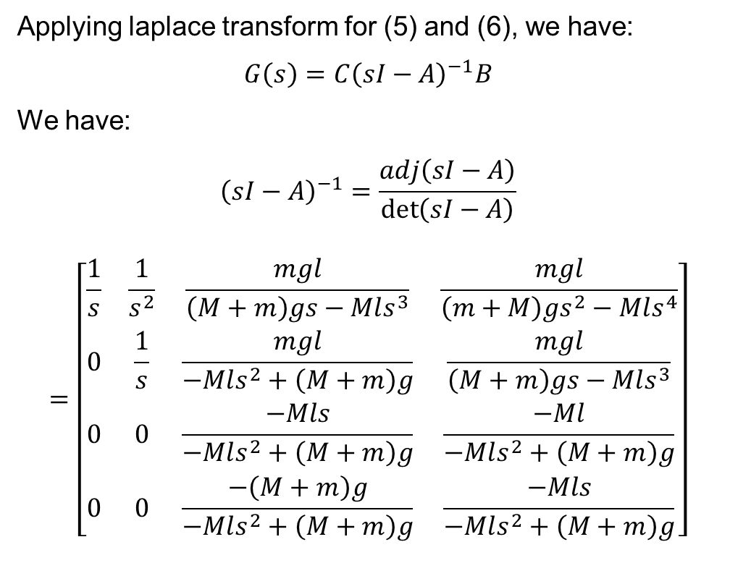

Q3: Transfer functions $G_{θ}$ and $G_{p}$
Control of Inverted pendulum
Applying laplace transform for (5) and (6), we have:
$$G\left(s\right)=C{\left(sI−A\right)}^{−1}B$$
We have:
$${\left(sI−A\right)}^{−1}=\frac{adj\left(sI−A\right)}{\det\left(sI−A\right)}$$
$$=\left[\begin{matrix}\frac{1}{s} & \frac{1}{s^{2}} & \frac{mgl}{\left(M+m\right)gs−Mls^{3}} & \frac{mgl}{\left(m+M\right)gs^{2}−Mls^{4}} \\ 0 & \frac{1}{s} & \frac{mgl}{−Mls^{2}+\left(M+m\right)g} & \frac{mgl}{\left(M+m\right)gs−Mls^{3}} \\ 0 & 0 & \frac{−Mls}{−Mls^{2}+\left(M+m\right)g} & \frac{−Ml}{−Mls^{2}+\left(M+m\right)g} \\ 0 & 0 & \frac{−\left(M+m\right)g}{−Mls^{2}+\left(M+m\right)g} & \frac{−Mls}{−Mls^{2}+\left(M+m\right)g}\end{matrix}\right]$$

Slide 12
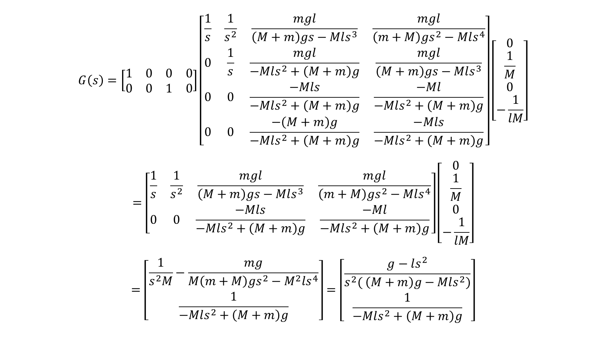
Q3: Transfer functions $G_{θ}$ and $G_{p}$
Control of Inverted pendulum
$$G\left(s\right)=\left[\begin{matrix}1 & 0 & 0 & 0 \\ 0 & 0 & 1 & 0\end{matrix}\right]\left[\begin{matrix}\frac{1}{s} & \frac{1}{s^{2}} & \frac{mgl}{\left(M+m\right)gs−Mls^{3}} & \frac{mgl}{\left(m+M\right)gs^{2}−Mls^{4}} \\ 0 & \frac{1}{s} & \frac{mgl}{−Mls^{2}+\left(M+m\right)g} & \frac{mgl}{\left(M+m\right)gs−Mls^{3}} \\ 0 & 0 & \frac{−Mls}{−Mls^{2}+\left(M+m\right)g} & \frac{−Ml}{−Mls^{2}+\left(M+m\right)g} \\ 0 & 0 & \frac{−\left(M+m\right)g}{−Mls^{2}+\left(M+m\right)g} & \frac{−Mls}{−Mls^{2}+\left(M+m\right)g}\end{matrix}\right]\left[\begin{matrix}0 \\ \frac{1}{M} \\ 0 \\ −\frac{1}{lM}\end{matrix}\right]$$
$$=\left[\begin{matrix}\frac{1}{s} & \frac{1}{s^{2}} & \frac{mgl}{\left(M+m\right)gs−Mls^{3}} & \frac{mgl}{\left(m+M\right)gs^{2}−Mls^{4}} \\ 0 & 0 & \frac{−Mls}{−Mls^{2}+\left(M+m\right)g} & \frac{−Ml}{−Mls^{2}+\left(M+m\right)g}\end{matrix}\right]\left[\begin{matrix}0 \\ \frac{1}{M} \\ 0 \\ −\frac{1}{lM}\end{matrix}\right]$$
$$=\left[\begin{matrix}\frac{1}{s^{2}M}−\frac{mg}{M\left(m+M\right)gs^{2}−M^{2}ls^{4}} \\ \frac{1}{−Mls^{2}+\left(M+m\right)g}\end{matrix}\right]=\left[\begin{matrix}\frac{g−ls^{2}}{s^{2}( \left(M+m\right)g−Mls^{2})} \\ \frac{1}{−Mls^{2}+\left(M+m\right)g}\end{matrix}\right]$$

Slide 13
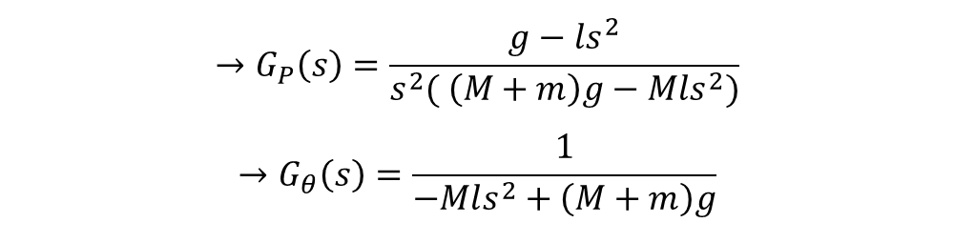
Q3: Transfer functions $G_{θ}$ and $G_{p}$
Control of Inverted pendulum
$$→G_{P}\left(s\right)=\frac{g−ls^{2}}{s^{2}( \left(M+m\right)g−Mls^{2})}$$
$$→G_{θ}\left(s\right)=\frac{1}{−Mls^{2}+\left(M+m\right)g}$$

Slide 14
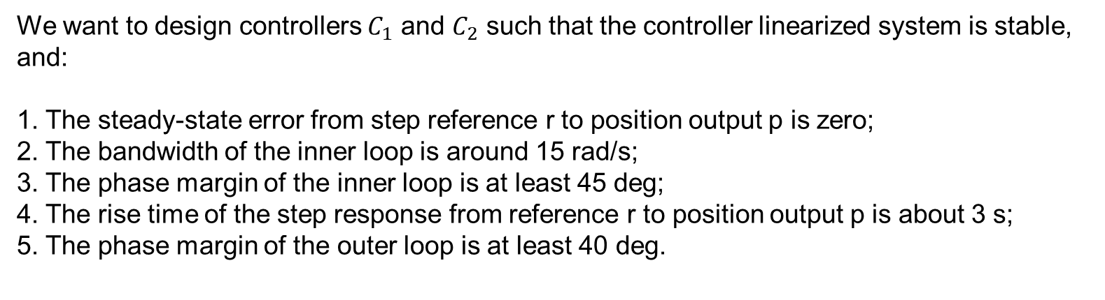
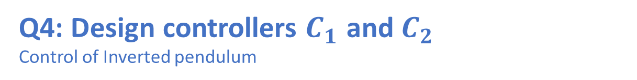
Q4: Design controllers $C_{1}$ and $C_{2}$
Control of Inverted pendulum
We want to design controllers $C_{1}$ and $C_{2}$ such that the controller linearized system is stable, and:
1. The steady-state error from step reference r to position output p is zero;
2. The bandwidth of the inner loop is around 15 rad/s;
3. The phase margin of the inner loop is at least 45 deg;
4. The rise time of the step response from reference r to position output p is about 3 s;
5. The phase margin of the outer loop is at least 40 deg.

Slide 15
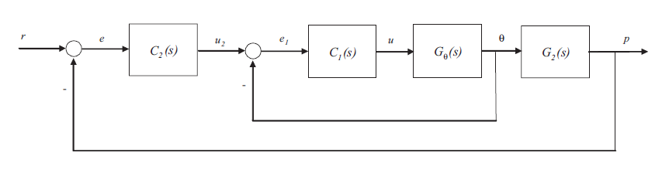
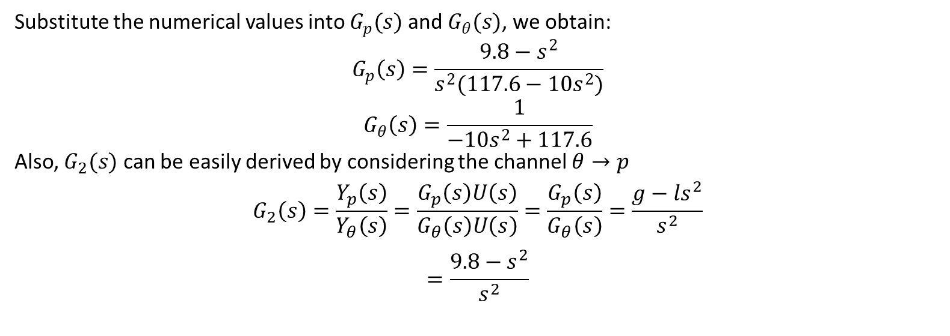
Q4: Design controllers $C_{1}$ and $C_{2}$
Control of Inverted pendulum
Substitute the numerical values into $G_{p}(s)$ and $G_{θ}(s)$, we obtain:
$$G_{p}\left(s\right)=\frac{9.8−s^{2}}{s^{2}(117.6−10s^{2})}$$
$$G_{θ}\left(s\right)=\frac{1}{−10s^{2}+117.6}$$
Also, $G_{2}(s)$ can be easily derived by considering the channel $θ→p$
$$G_{2}\left(s\right)=\frac{Y_{p}\left(s\right)}{Y_{θ}\left(s\right)}=\frac{G_{p}\left(s\right)U\left(s\right)}{G_{θ}\left(s\right)U\left(s\right)}=\frac{G_{p}\left(s\right)}{G_{θ}\left(s\right)}=\frac{g−ls^{2}}{s^{2}}$$
$$=\frac{9.8−s^{2}}{s^{2}}$$

Slide 16
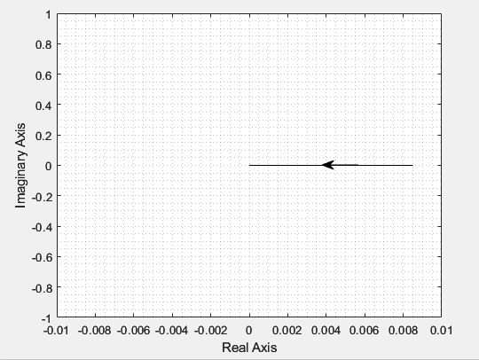
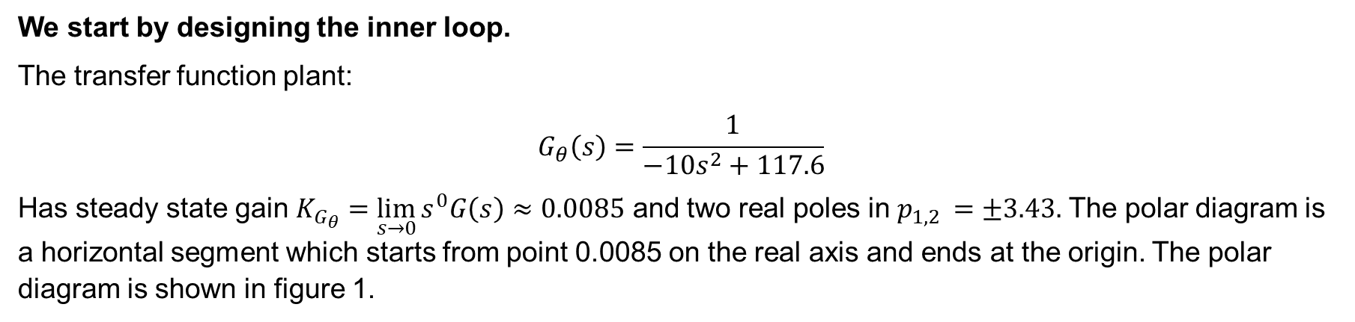
Q4: Design controllers $C_{1}$ and $C_{2}$
Control of Inverted pendulum
We start by designing the inner loop.
The transfer function plant:
$$G_{θ}\left(s\right)=\frac{1}{−10s^{2}+117.6}$$
Has steady state gain $K_{G_{θ}}=\lim_{s→0}{s^{0}G\left(s\right)≈0.0085}$ and two real poles in $p_{1,2 }=±3.43.$ The polar diagram is a horizontal segment which starts from point 0.0085 on the real axis and ends at the origin. The polar diagram is shown in figure 1.
$$Figure 1: Polar plot of G_{θ }$$

Slide 17
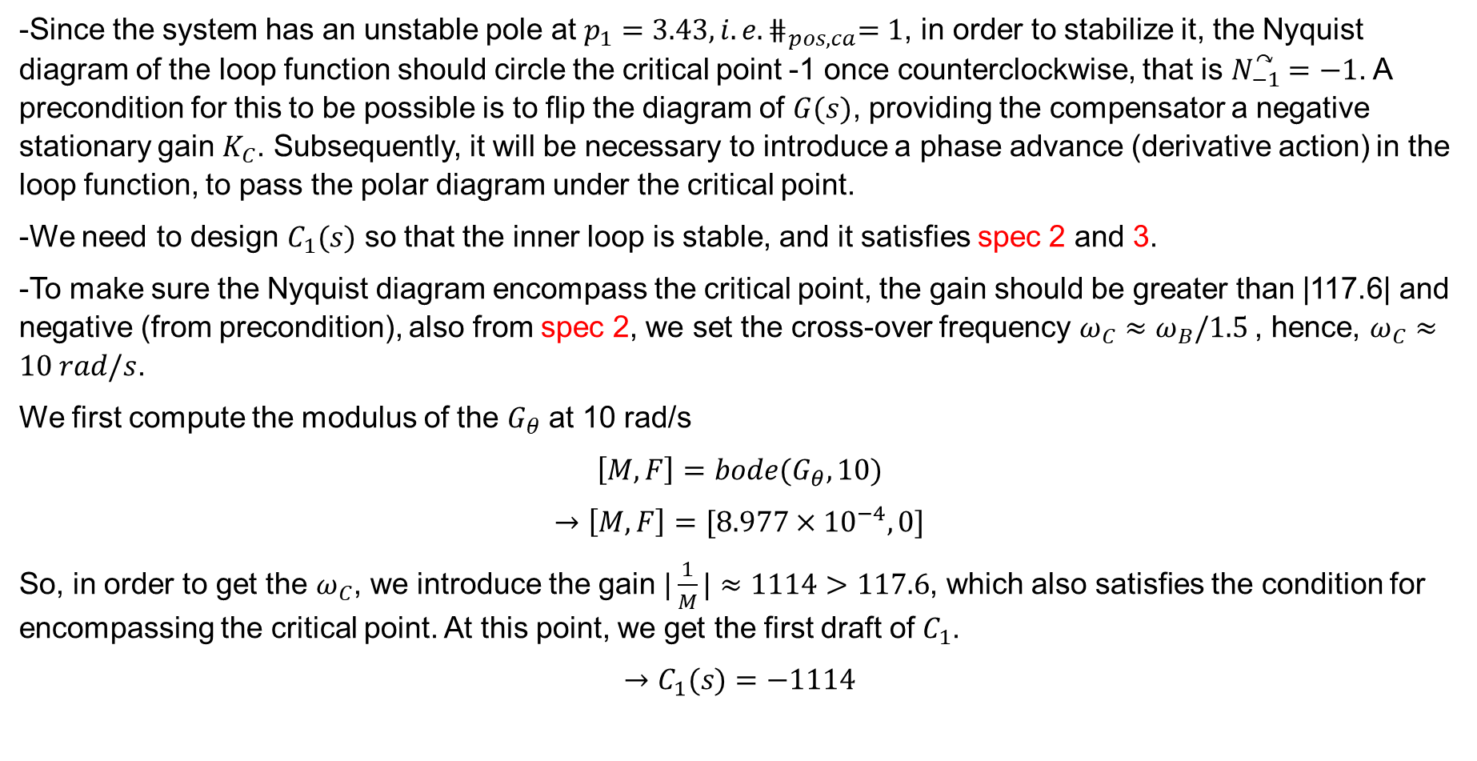
Q4: Design controllers $C_{1}$ and $C_{2}$
Control of Inverted pendulum
-Since the system has an unstable pole at $p_{1}=3.43, i.e. ⋕_{pos, ca}=1$, in order to stabilize it, the Nyquist diagram of the loop function should circle the critical point -1 once counterclockwise, that is $N_{−1}^{↷}=−1$. A precondition for this to be possible is to flip the diagram of $G(s)$, providing the compensator a negative stationary gain $K_{C}$. Subsequently, it will be necessary to introduce a phase advance (derivative action) in the loop function, to pass the polar diagram under the critical point.
-We need to design $C_{1}(s)$ so that the inner loop is stable, and it satisfies spec 2 and 3.
-To make sure the Nyquist diagram encompass the critical point, the gain should be greater than |117.6| and negative (from precondition), also from spec 2, we set the cross-over frequency $ω_{C}≈ω_{B}/1.5$, hence, $ω_{C}≈10 rad/s$.
We first compute the modulus of the $G_{θ}$ at 10 rad/s
$$\left[M,F\right]=bode(G_{θ},10)$$
$$→\left[M,F\right]=[8.977×{10}^{−4}, 0]$$
So, in order to get the $ω_{C}$, we introduce the gain $|\frac{1}{M}|≈1114>117.6$, which also satisfies the condition for encompassing the critical point. At this point, we get the first draft of $C_{1}$.
$$→C_{1}(s)=−1114$$

Slide 18
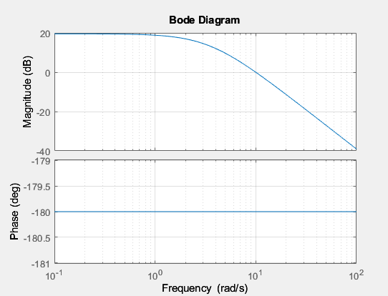
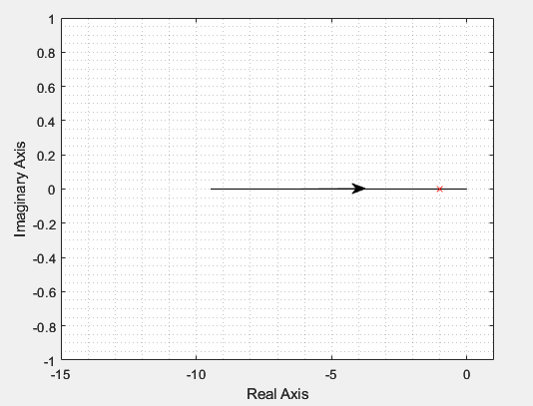
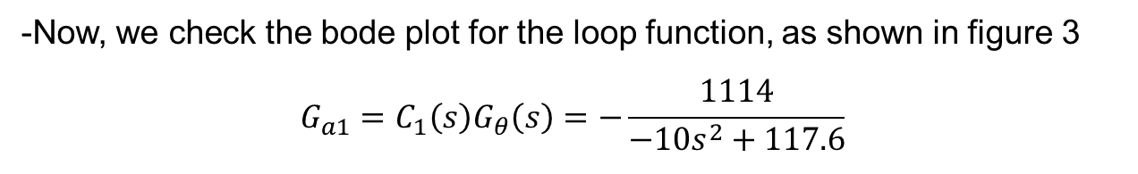
Q4: Design controllers $C_{1}$ and $C_{2}$
Control of Inverted pendulum
$$figure 2:Polar plot of G_{θ}$$
$$Figure 3:Bode plot of the loop function G_{a1}$$
-Now, we check the bode plot for the loop function, as shown in figure 3
$$G_{a1}=C_{1}\left(s\right)G_{θ}\left(s\right)=−\frac{1114}{−10s^{2}+117.6}$$

Slide 19
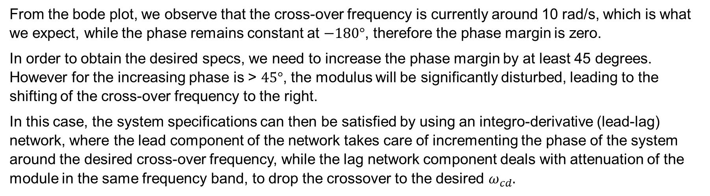
Q4: Design controllers $C_{1}$ and $C_{2}$
Control of Inverted pendulum
From the bode plot, we observe that the cross-over frequency is currently around 10 rad/s, which is what we expect, while the phase remains constant at $−180°$, therefore the phase margin is zero.
In order to obtain the desired specs, we need to increase the phase margin by at least 45 degrees. However for the increasing phase is > $45°$, the modulus will be significantly disturbed, leading to the shifting of the cross-over frequency to the right.
In this case, the system specifications can then be satisfied by using an integro-derivative (lead-lag) network, where the lead component of the network takes care of incrementing the phase of the system around the desired cross-over frequency, while the lag network component deals with attenuation of the module in the same frequency band, to drop the crossover to the desired $ω_{cd}.$

Slide 20
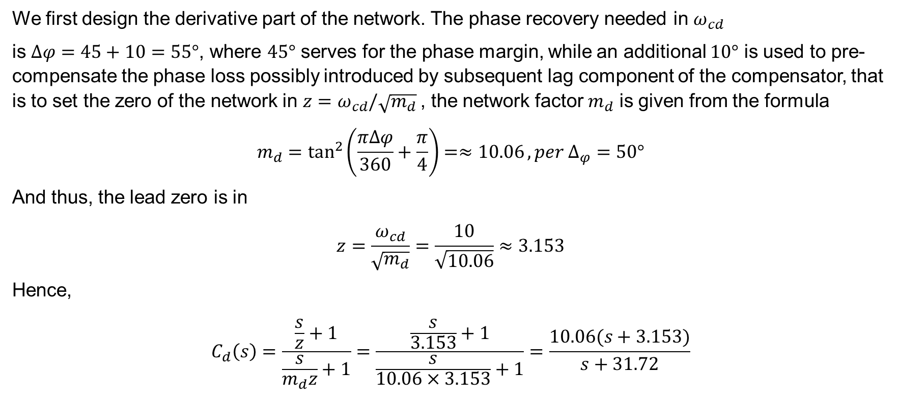
Q4: Design controllers $C_{1}$ and $C_{2}$
Control of Inverted pendulum
We first design the derivative part of the network. The phase recovery needed in $ω_{cd}$
is $Δφ=45+10=55°$, where $45°$ serves for the phase margin, while an additional $10°$ is used to pre-compensate the phase loss possibly introduced by subsequent lag component of the compensator, that is to set the zero of the network in $z=ω_{cd}/\sqrt{m_{d}}$, the network factor $m_{d}$ is given from the formula
$$m_{d}=\tan^{2}\left(\frac{πΔφ}{360}+\frac{π}{4}\right)=≈10.06, per Δ_{φ}=50°$$
And thus, the lead zero is in
$$z=\frac{ω_{cd}}{\sqrt{m_{d}}}=\frac{10}{\sqrt{10.06}}≈3.153$$
Hence,
$$C_{d}\left(s\right)=\frac{\frac{s}{z}+1}{\frac{s}{m_{d}z}+1}=\frac{\frac{s}{3.153}+1}{\frac{s}{10.06×3.153}+1}=\frac{10.06(s+3.153)}{s+31.72}$$

Slide 21
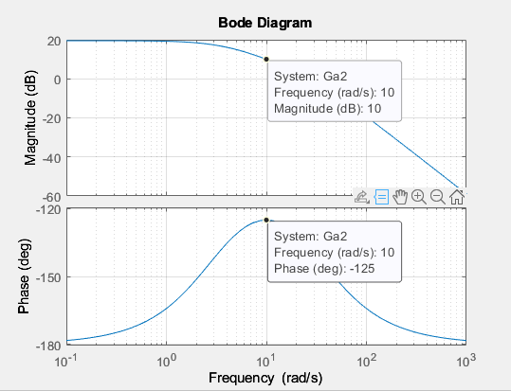
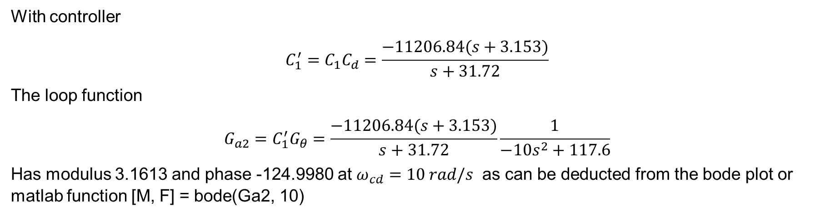
Q4: Design controllers $C_{1}$ and $C_{2}$
Control of Inverted pendulum
With controller
$$C_{1}^{′}=C_{1}C_{d}=\frac{−11206.84(s+3.153)}{s+31.72}$$
The loop function
$$G_{a2}=C_{1}^{′}G_{θ}=\frac{−11206.84(s+3.153)}{s+31.72}\frac{1}{−10s^{2}+117.6}$$
Has modulus 3.1613 and phase -124.9980 at $ω_{cd}=10 rad/s$ as can be deducted from the bode plot or matlab function [M, F] = bode(Ga2, 10)
$$Figure 4:Bode plot of the loop function G_{a2}$$

Slide 22
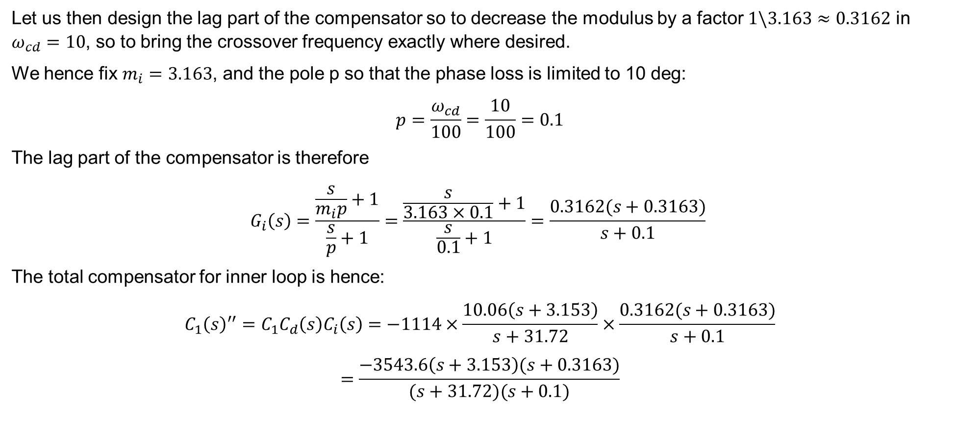
Q4: Design controllers $C_{1}$ and $C_{2}$
Control of Inverted pendulum
Let us then design the lag part of the compensator so to decrease the modulus by a factor $1\backslash 3.163≈0.3162$ in $ω_{cd}=10$, so to bring the crossover frequency exactly where desired.
We hence fix $m_{i}=3.163$, and the pole p so that the phase loss is limited to 10 deg:
$$p=\frac{ω_{cd}}{100}=\frac{10}{100}=0.1$$
The lag part of the compensator is therefore
$$G_{i}\left(s\right)=\frac{\frac{s}{m_{i}p}+1}{\frac{s}{p}+1}=\frac{\frac{s}{3.163×0.1}+1}{\frac{s}{0.1}+1}=\frac{0.3162(s+0.3163)}{s+0.1}$$
The total compensator for inner loop is hence:
$$C_{1}{\left(s\right)}^{′′}=C_{1}C_{d}\left(s\right)C_{i}\left(s\right)=−1114×\frac{10.06\left(s+3.153\right)}{s+31.72}×\frac{0.3162(s+0.3163)}{s+0.1}$$
$$=\frac{−3543.6\left(s+3.153\right)(s+0.3163)}{(s+31.72)(s+0.1)}$$

Slide 23
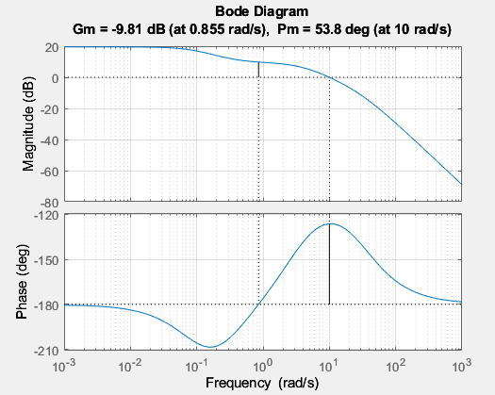
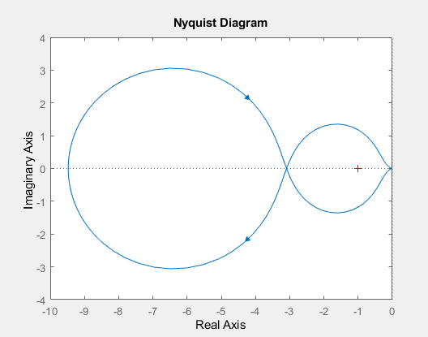
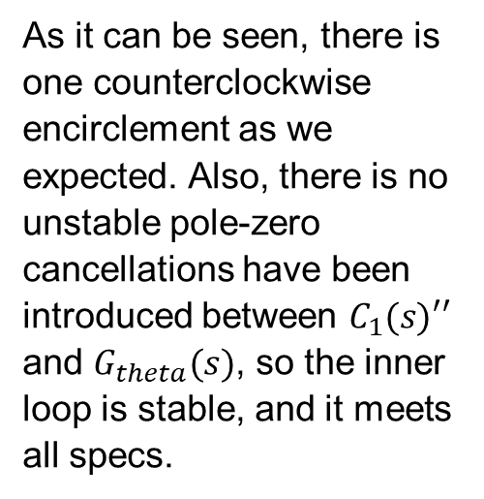
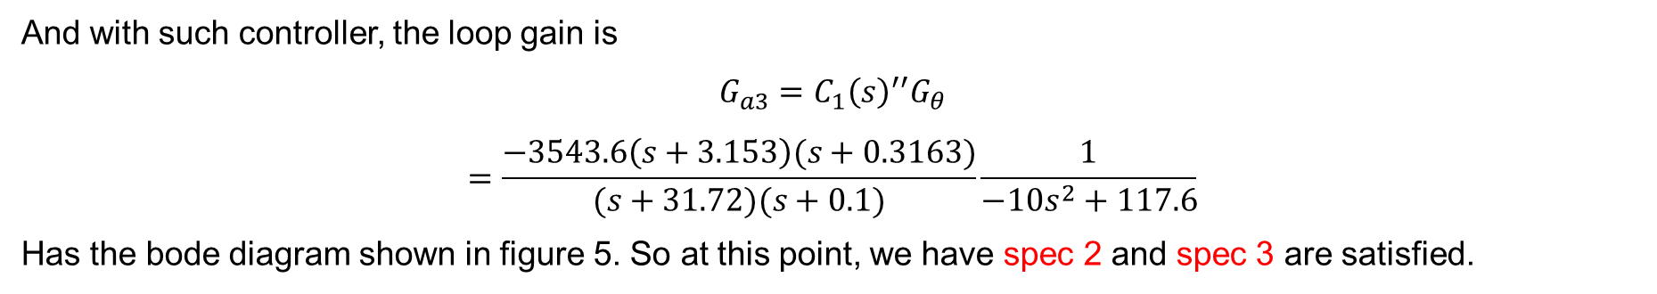
Q4: Design controllers $C_{1}$ and $C_{2}$
Control of Inverted pendulum
And with such controller, the loop gain is
$$G_{a3}=C_{1}{\left(s\right)}^{′′}G_{θ}$$
$$=\frac{−3543.6\left(s+3.153\right)(s+0.3163)}{(s+31.72)(s+0.1)}\frac{1}{−10s^{2}+117.6}$$
Has the bode diagram shown in figure 5. So at this point, we have spec 2 and spec 3 are satisfied.
As it can be seen, there is one counterclockwise encirclement as we expected. Also, there is no unstable pole-zero cancellations have been introduced between $C_{1}(s)′′$ and $G_{theta}(s)$, so the inner loop is stable, and it meets all specs.
$$Figure 5:The bode diagram of G_{a3}$$
$$Figure 6:The nyquist diagram of G_{a3}$$

Slide 24
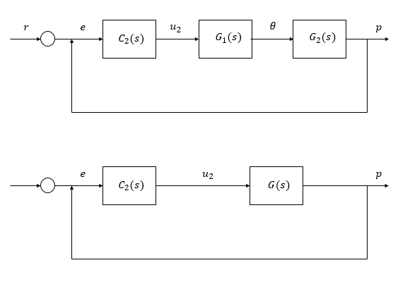
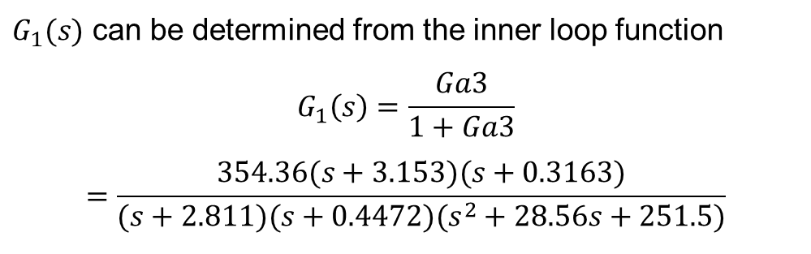
Q4: Design controllers $C_{1}$ and $C_{2}$
Control of Inverted pendulum
Now we move to the outer loop
$G_{1}(s)$ can be determined from the inner loop function
$$G_{1}\left(s\right)=\frac{Ga3}{1+Ga3}$$
$$=\frac{354.36(s+3.153)(s+0.3163)}{(s+2.811)(s+0.4472)(s^{2}+28.56s+251.5)}$$

Slide 25

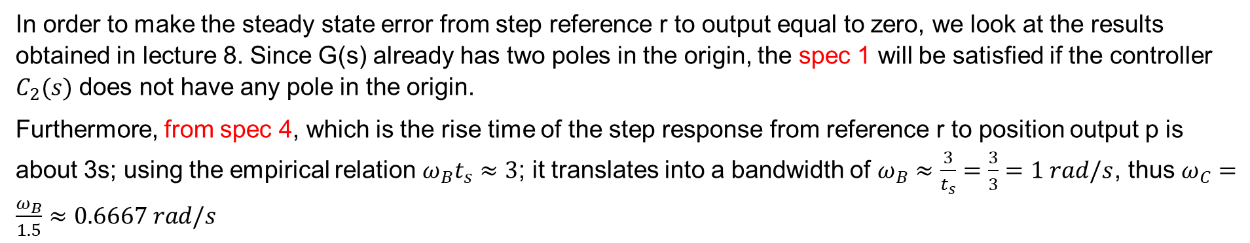
Q4: Design controllers $C_{1}$ and $C_{2}$
Control of Inverted pendulum
The combined plant functions
$$G\left(s\right)=G_{1}\left(s\right)G_{2}(s)$$
$$G\left(s\right)=\frac{354.36(s+3.153)(s+0.3163)(9.8−s^{2})}{s^{2}(s+2.811)(s+0.4472)(s^{2}+28.56s+251.5)}$$
In order to make the steady state error from step reference r to output equal to zero, we look at the results obtained in lecture 8. Since G(s) already has two poles in the origin, the spec 1 will be satisfied if the controller $C_{2}(s)$ does not have any pole in the origin.
Furthermore, from spec 4, which is the rise time of the step response from reference r to position output p is about 3s; using the empirical relation $ω_{B}t_{s}≈3$; it translates into a bandwidth of $ω_{B}≈\frac{3}{t_{s}}=\frac{3}{3}=1 rad/s$, thus $ω_{C}=\frac{ω_{B}}{1.5}≈0.6667 rad/s$

Slide 26
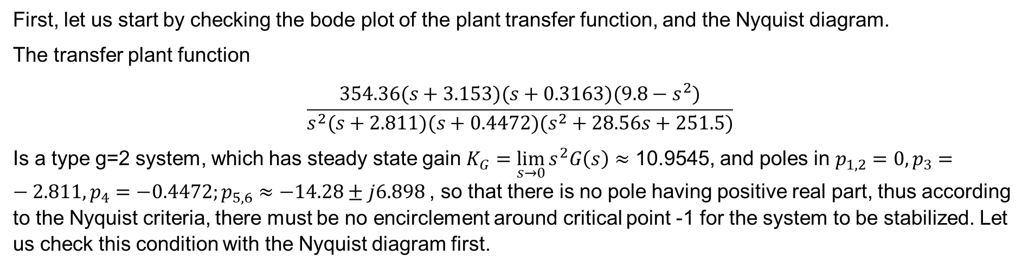
Q4: Design controllers $C_{1}$ and $C_{2}$
Control of Inverted pendulum
First, let us start by checking the bode plot of the plant transfer function, and the Nyquist diagram.
The transfer plant function
$$\frac{354.36(s+3.153)(s+0.3163)(9.8−s^{2})}{s^{2}(s+2.811)(s+0.4472)(s^{2}+28.56s+251.5)}$$
Is a type g=2 system, which has steady state gain $K_{G}=\lim_{s→0}{s^{2}G\left(s\right)≈}$ 10.9545, and poles in $p_{1,2}=0, p_{3}=−2.811, p_{4}=−0.4472;p_{5,6}≈−14.28±j6.898$, so that there is no pole having positive real part, thus according to the Nyquist criteria, there must be no encirclement around critical point -1 for the system to be stabilized. Let us check this condition with the Nyquist diagram first.

Slide 27
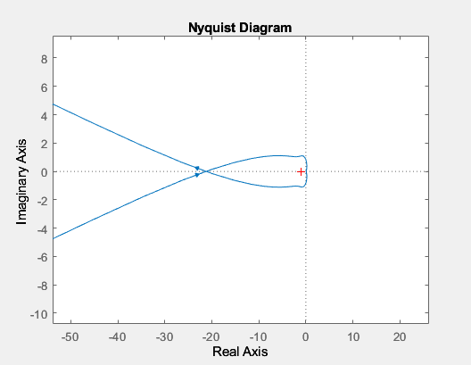
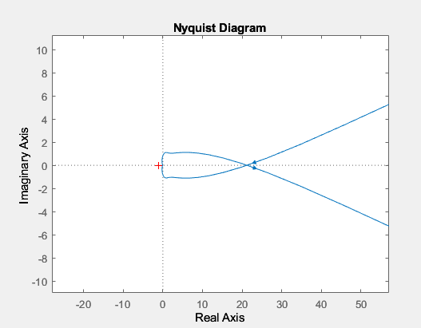
Q4: Design controllers $C_{1}$ and $C_{2}$
Control of Inverted pendulum
$$Figure 7:Nyquist plot of G\left(s\right),$$
$$Figure 8:Nyquist plot of−G\left(s\right),$$
By observing from the Nyquist diagram, we realize that there are two clockwise encirclements (one cause by infinite semicircle due to the pole at zero), so the system does not meet the Nyquist criteria, thus it is not stable.
Flipping the Nyquist plot is my first try. However, there is always one

Slide 28
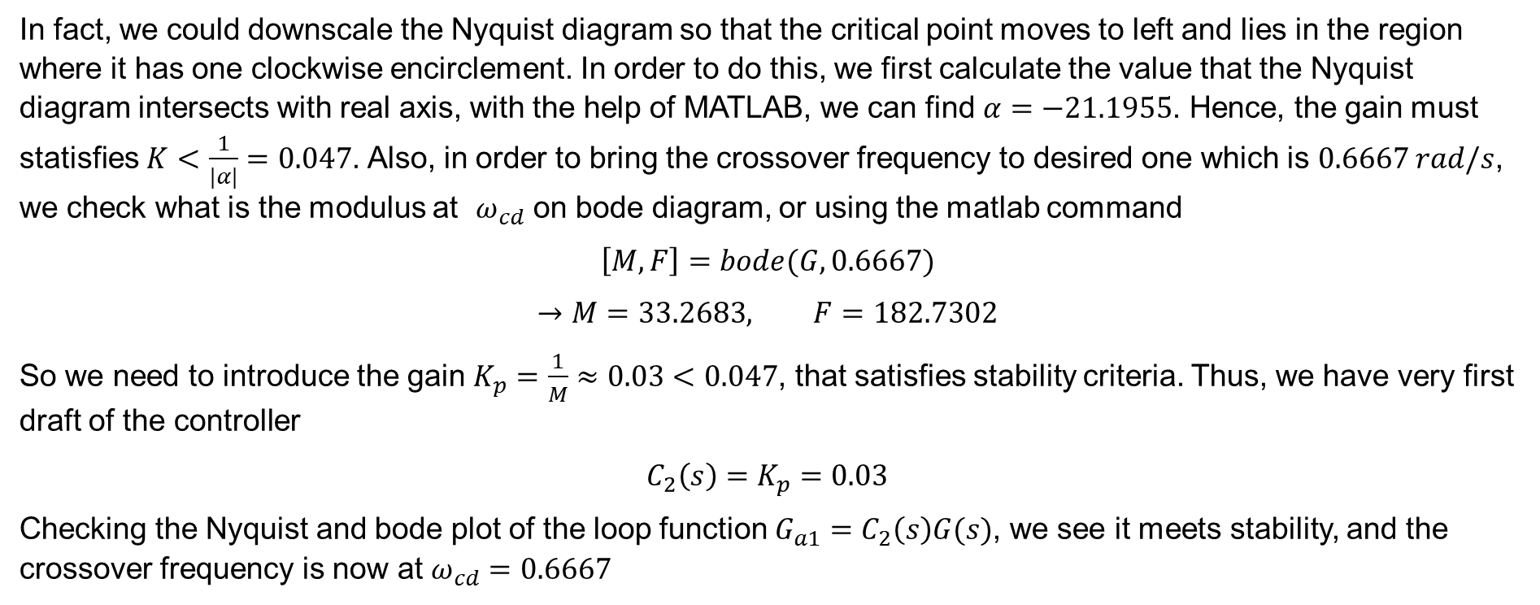
Q4: Design controllers $C_{1}$ and $C_{2}$
Control of Inverted pendulum
In fact, we could downscale the Nyquist diagram so that the critical point moves to left and lies in the region where it has one clockwise encirclement. In order to do this, we first calculate the value that the Nyquist diagram intersects with real axis, with the help of MATLAB, we can find $α=−21.1955$. Hence, the gain must statisfies $K<\frac{1}{|α|}=0.047$. Also, in order to bring the crossover frequency to desired one which is $0.6667 rad/s$, we check what is the modulus at $ω_{cd}$ on bode diagram, or using the matlab command
$$\left[M, F\right]=bode(G, 0.6667)$$
$$→M=33.2683, F=182.7302$$
So we need to introduce the gain $K_{p}=\frac{1}{M}≈0.03<0.047$, that satisfies stability criteria. Thus, we have very first draft of the controller
$$C_{2}\left(s\right)=K_{p}=0.03$$
Checking the Nyquist and bode plot of the loop function $G_{a1}=C_{2}\left(s\right)G(s)$, we see it meets stability, and the crossover frequency is now at $ω_{cd}=0.6667$

Slide 29
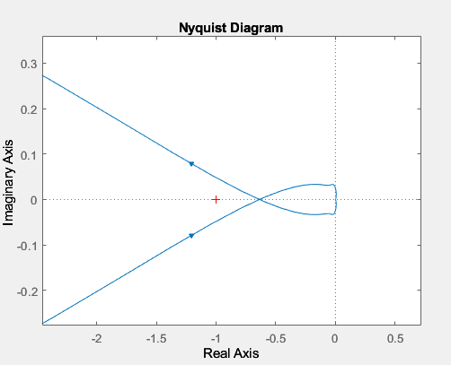
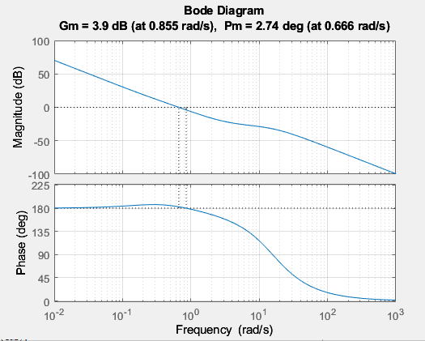
Q4: Design controllers $C_{1}$ and $C_{2}$
Control of Inverted pendulum
$$Figure 9:Nyquist plot ofG_{a1}\left(s\right)$$
$$Figure 10:Bode plot ofG_{a1}\left(s\right),$$

Slide 30
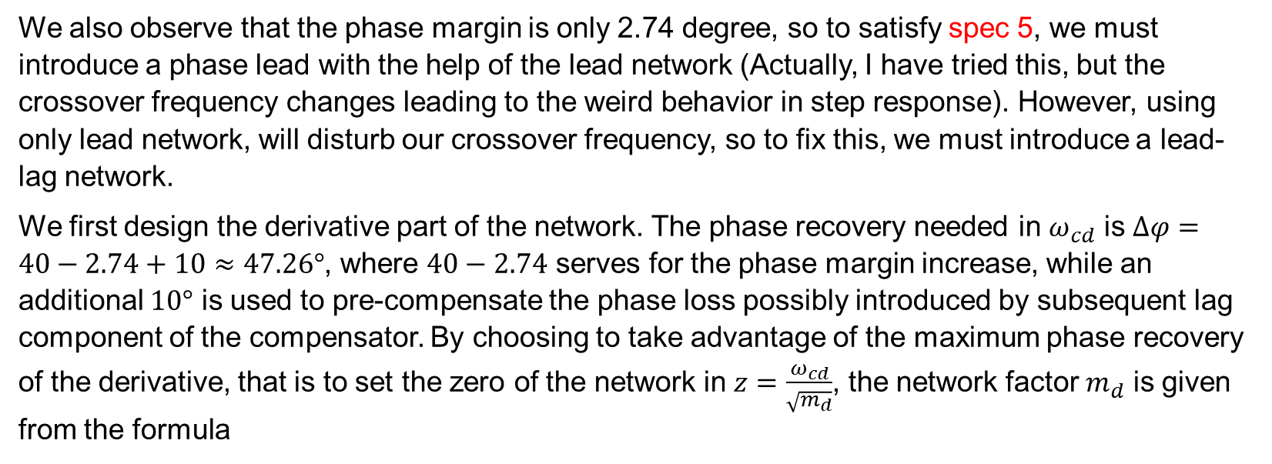
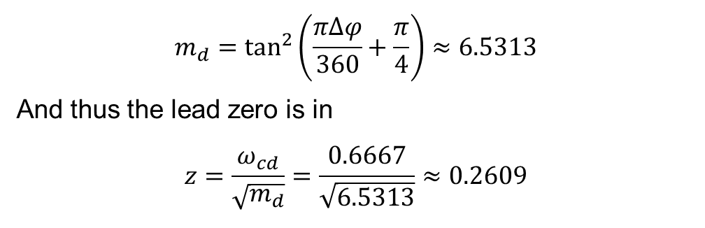
Q4: Design controllers $C_{1}$ and $C_{2}$
Control of Inverted pendulum
We also observe that the phase margin is only 2.74 degree, so to satisfy spec 5, we must introduce a phase lead with the help of the lead network (Actually, I have tried this, but the crossover frequency changes leading to the weird behavior in step response). However, using only lead network, will disturb our crossover frequency, so to fix this, we must introduce a lead-lag network.
We first design the derivative part of the network. The phase recovery needed in $ω_{cd}$ is $Δφ=40−2.74+10≈47.26°$, where $40−2.74$ serves for the phase margin increase, while an additional $10°$ is used to pre-compensate the phase loss possibly introduced by subsequent lag component of the compensator. By choosing to take advantage of the maximum phase recovery of the derivative, that is to set the zero of the network in $z=\frac{ω_{cd}}{\sqrt{m_{d}}}$, the network factor $m_{d}$ is given from the formula
$$m_{d}=\tan^{2}\left(\frac{πΔφ}{360}+\frac{π}{4}\right)≈6.5313$$
And thus the lead zero is in
$$z=\frac{ω_{cd}}{\sqrt{m_{d}}}=\frac{0.6667}{\sqrt{6.5313}}≈0.2609$$

Slide 31
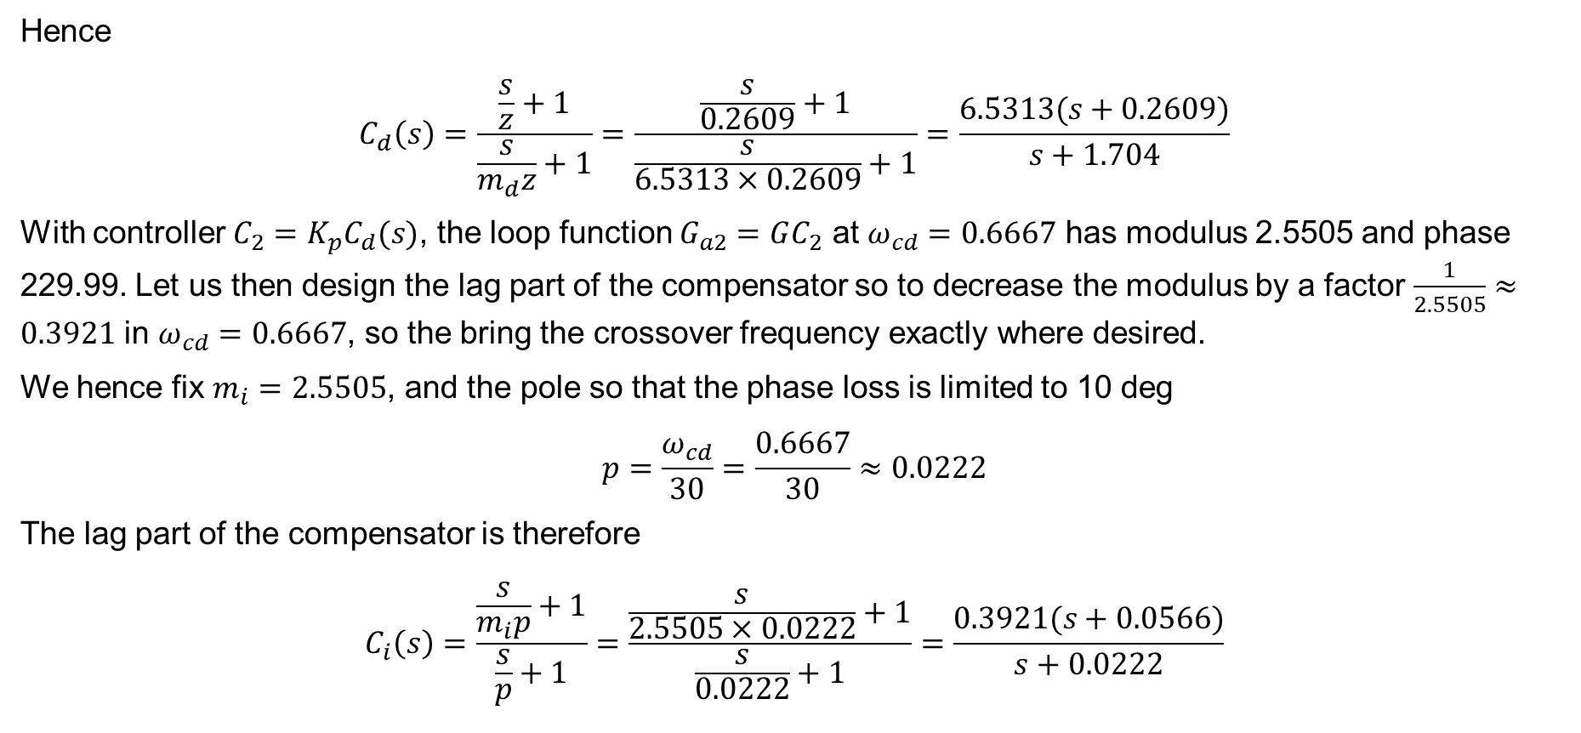
Q4: Design controllers $C_{1}$ and $C_{2}$
Control of Inverted pendulum
Hence
$$C_{d}\left(s\right)=\frac{\frac{s}{z}+1}{\frac{s}{m_{d}z}+1}=\frac{\frac{s}{0.2609}+1}{\frac{s}{6.5313×0.2609}+1}=\frac{6.5313(s+0.2609)}{s+1.704}$$
With controller $C_{2}=K_{p}C_{d}(s)$, the loop function $G_{a2}=GC_{2}$ at $ω_{cd}=0.6667$ has modulus 2.5505 and phase 229.99. Let us then design the lag part of the compensator so to decrease the modulus by a factor $\frac{1}{2.5505}≈0.3921$ in $ω_{cd}=0.6667$, so the bring the crossover frequency exactly where desired.
We hence fix $m_{i}=2.5505$, and the pole so that the phase loss is limited to 10 deg
$$p=\frac{ω_{cd}}{30}=\frac{0.6667}{30}≈0.0222$$
The lag part of the compensator is therefore
$$C_{i}\left(s\right)=\frac{\frac{s}{m_{i}p}+1}{\frac{s}{p}+1}=\frac{\frac{s}{2.5505×0.0222}+1}{\frac{s}{0.0222}+1}=\frac{0.3921(s+0.0566)}{s+0.0222}$$

Slide 32
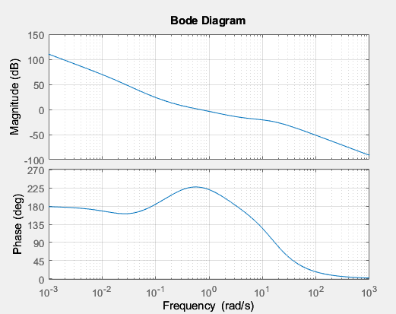
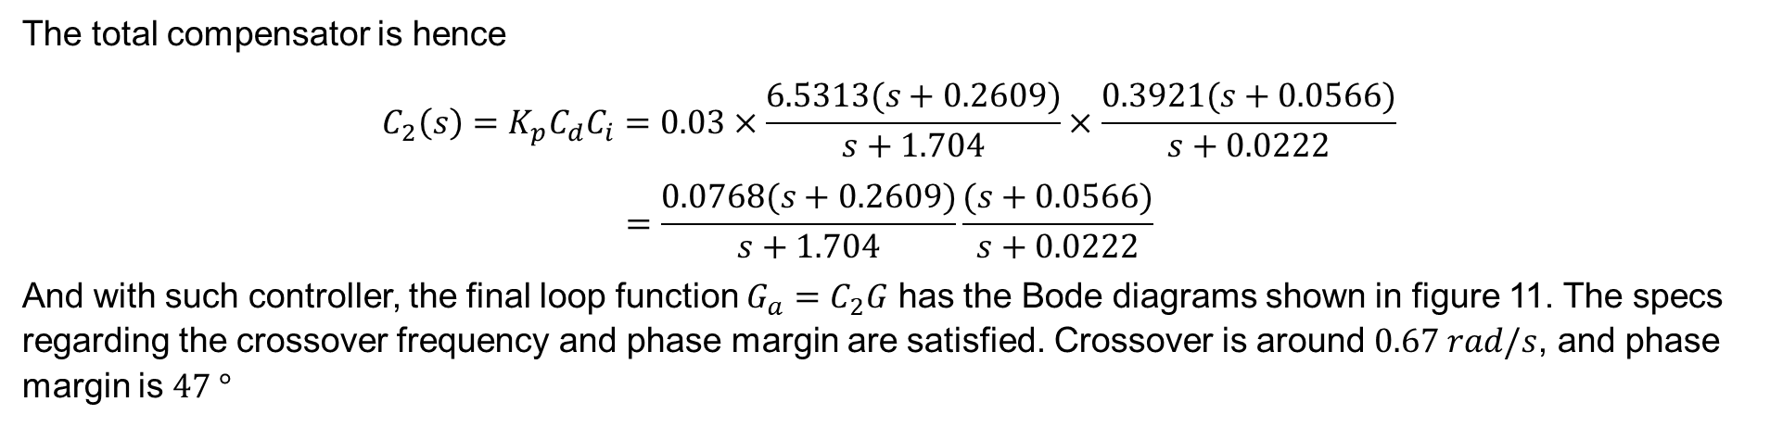
Q4: Design controllers $C_{1}$ and $C_{2}$
Control of Inverted pendulum
The total compensator is hence
$$C_{2}\left(s\right)=K_{p}C_{d}C_{i}=0.03×\frac{6.5313(s+0.2609)}{s+1.704}×\frac{0.3921(s+0.0566)}{s+0.0222}$$
$$=\frac{0.0768(s+0.2609)}{s+1.704}\frac{(s+0.0566)}{s+0.0222}$$
And with such controller, the final loop function $G_{a}=C_{2}G$ has the Bode diagrams shown in figure 11. The specs regarding the crossover frequency and phase margin are satisfied. Crossover is around $0.67 rad/s$, and phase margin is $47 °$
$$Figure 11:Bode plot of Ga$$

Slide 33
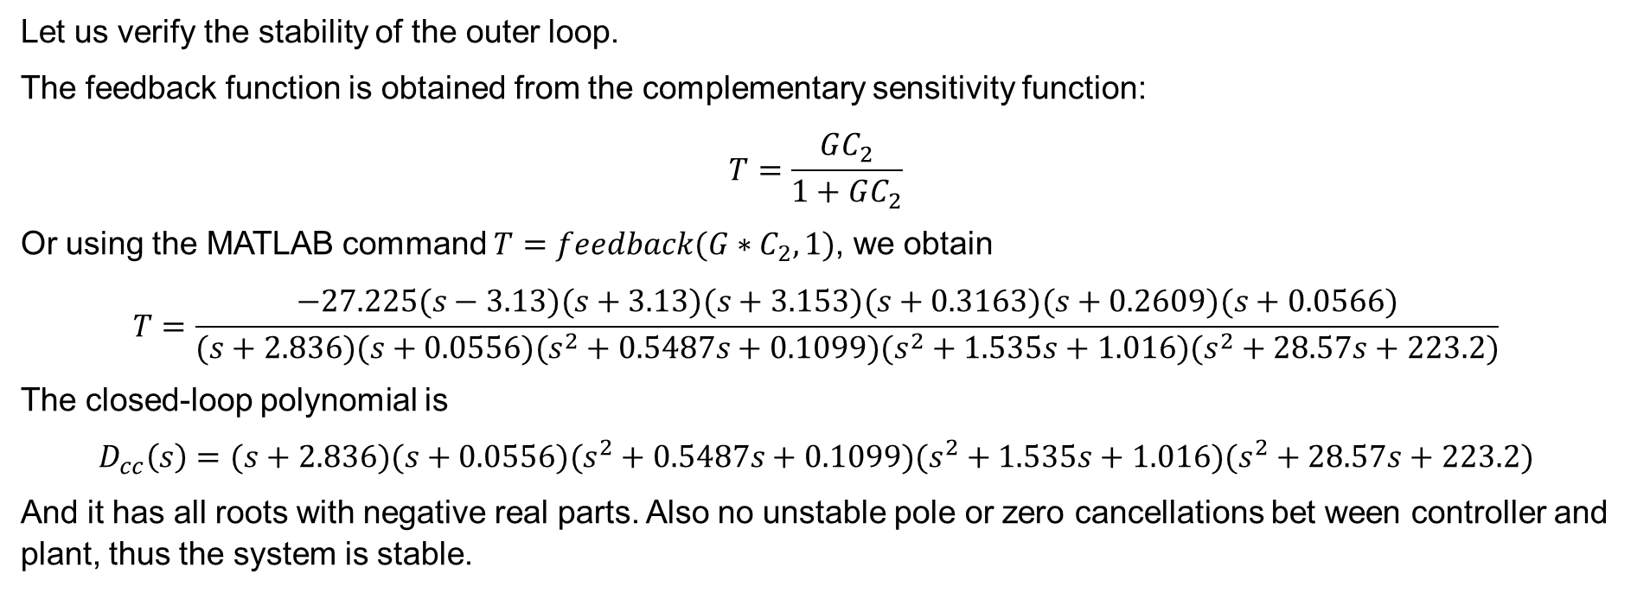
Q4: Design controllers $C_{1}$ and $C_{2}$
Control of Inverted pendulum
Let us verify the stability of the outer loop.
The feedback function is obtained from the complementary sensitivity function:
$$T=\frac{GC_{2}}{1+GC_{2}}$$
Or using the MATLAB command $T=feedback(G∗C_{2},1)$, we obtain
$$T=\frac{−27.225(s−3.13)(s+3.13)(s+3.153)(s+0.3163)(s+0.2609)(s+0.0566)}{(s+2.836)(s+0.0556)(s^{2}+0.5487s+0.1099)(s^{2}+1.535s+1.016)(s^{2}+28.57s+223.2)}$$
The closed-loop polynomial is
$$D_{cc}\left(s\right)=(s+2.836)(s+0.0556)(s^{2}+0.5487s+0.1099)(s^{2}+1.535s+1.016)(s^{2}+28.57s+223.2)$$
And it has all roots with negative real parts. Also no unstable pole or zero cancellations bet ween controller and plant, thus the system is stable.

Slide 34
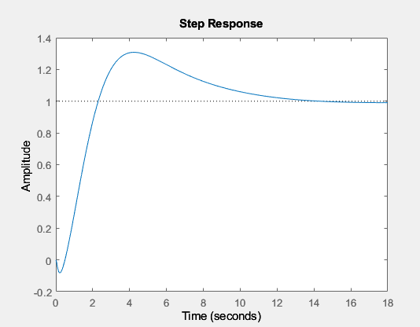
Q4: Design controllers $C_{1}$ and $C_{2}$
Control of Inverted pendulum
Let us then check the step response
$$Figure 12:Step response$$
Oops!! What’s wrong!!! The rise time is not around 3 s

Slide 35

Q4: Design controllers $C_{1}$ and $C_{2}$
Control of Inverted pendulum
Due to the existence of non-minimum phase zero, which limits the rise time, the rise time does not meet specs. This is because the bandwidth we calculated from empirical formula is only for minimum phase system. Removing the minimum phase zero is impossible, because it affects the stability of the system. In order to shift the system to the right bandwidth, we first try to introduce the gain K to the loop function, but we also need to guarantee the stability of the system.
$$Figure 13:Step response corresponding with different gains$$

Slide 36

Q4: Design controllers $C_{1}$ and $C_{2}$
Control of Inverted pendulum
As it can be seen from figure 13, the rise time increases as we introducing the gain < 1. Fortunately, we can obtain the rise time of approximately 3 (from 0.581 to 3.5) by introducing the gain K =0.5 to the loop function. However, the undershoot decreases, and settling time increases.
$$Figure 14:Step response corresponding with different gains$$

Slide 37

Q4: Design controllers $C_{1}$ and $C_{2}$
Control of Inverted pendulum
We now modify our controller to achieve the rise time of about 3.
$$C_{2}\left(s\right)=\frac{0.0384(s+0.2609)}{s+1.704}\frac{(s+0.0566)}{s+0.0222}$$
Also, to assure the system is still stable, we analyze the closed-loop polynomial:
$$D_{cc}\left(s\right)=(s+2.825) (s+1.256) (s+0.5778) (s+0.05466) (s^{2} + 0.2723s + 0.07392) (s^{2} + 28.56s + 237.2)$$
So all the roots have negative real part, so the system remains stable.

Slide 38

Q5: Simulation and comparison between linearized and actual model
Control of Inverted pendulum

Slide 39

Q5: Simulation and comparison between linearized and actual model
Control of Inverted pendulum
Non-linear model

Slide 40

Q5: Simulation and comparison between linearized and actual model
Control of Inverted pendulum
Linearized model

Slide 41



Q5: Simulation and comparison between linearized and actual model
Control of Inverted pendulum
For step u = 1(t)

Slide 42



Q5: Simulation and comparison between linearized and actual model
Control of Inverted pendulum
For step u = 5(t)
At stronger perturbation, the responses of non-linear system starts to differ from linearized system

Slide 43



Q5: Simulation and comparison between linearized and actual model
Control of Inverted pendulum
For step u = 10(t)
The difference is more different, but the dynamics are basically similar.

Slide 44



Q5: Simulation and comparison between linearized and actual model
Control of Inverted pendulum
For step u = 15(t)
For high value of peak of theta, the non-linear starts to be so much different from the linearized model, but the controller still can control the steady state error.

Slide 45



Q5: Simulation and comparison between linearized and actual model
Control of Inverted pendulum
For step u = 20(t)
T

Slide 46



Q5: Simulation and comparison between linearized and actual model
Control of Inverted pendulum
For step u = 25(t)
The dynamics of linearized model cannot catch the actual model. However, the system still control the position and angle to desired ones.

Slide 47

Q5: Simulation and comparison between linearized and actual model
Control of Inverted pendulum
Conclusion
The linearized model can fit well the actual non-linear model with small values of theta (around 0-0.5 for peak $θ$)
The dynamics change significantly with high values of $θ$, but the controllers still do good in bringing the pendulum position and angle to desired positions. However, the command must work really hard to do it, as it can be shown from above figure
There are always slight overshoots

Slide 48
What we learn from this project?
Control of Inverted pendulum
-Deriving state space model of non-linear systems, linearized systems
-Assessing stability of open-loop, and closed loop systems using characteristic polynomials, Nyquist diagrams, polar diagrams, bode diagrams
-Designing compensators to meet the specifications
-Using Simulink to verify our results

Slide 49
Thank you for listening!! Happy Tet’s Holiday!!

